Slide 1
Observing Changes In Matter
Unit 3 Matter and Chemical Change

Slide 2
There are 2 types of change:
________Change - one in which a material changes from one state to another and can change back into its original state.
(eg) Salt dissolved in water.
Frozen juice thawing
_________Change - occurs when two or more materials react and create new materials. The new materials have completely different properties from the original substances

Slide 3
Evidence of Chemical Change | Example
Change in colour | When bleach is added to the dye on a denim jacket, a noticeable colour change occurs.
Change in odour | When a match is struck, the substances in the match head react and give off a distinctive odour.
Formation of a solid (precipitate) or gas | When vinegar (a liquid) is added to baking soda (a solid), carbon dioxide gas is formed.
Release or absorption of heat energy | When gasoline burns in a car engine, heat is released. *Change is difficult or impossible to reverse

Slide 4
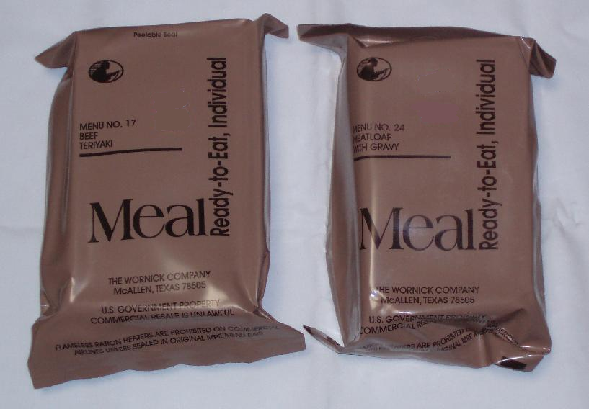
Controlling Change to Meet Human Needs
____________________Foods
Benefit – food can be eaten long after it was packaged (many months later)
_________uses this technique. (called MRE or meal ready to eat)
Two MRE packets: beef teriyaki and meatloaf with gravy
Notes:
This method of eating was established in 1981

Slide 5
More uses for chemical changes.
Corn can be made into __________, and paint and nail polish remover.
This is done through the chemical process of ___________________.
What is the benefit to these corn substances?

Slide 6
Check and Reflect pg 109
Questions 1-7

